Slide 1
Trial | Both # | Flow # | TSS # | Eps_q | Eps_TSS | Flow peak | Flow var | TSS peak | TSS var | TSS remain
A | 20 | 5 | 3 | 5 / 10 | 2.5 / 5 | 0.506 | 1920 | 0.213 | 0.0902 | 0.0732
B | 21 | 5 | 5 | 5 / 10 | 5 / 10 | 0.422 | 1370 | 0.130 | 0.0756 | 0.0407
C | 10 | 3 | 2 | 2.5 / 5 | 1 / 2.5 | 0.641 | 2100 | 0.402 | 0.139 | 0.101
D | 13 | 3 | 7 | 2.5 / 5 | 7.5 / 15 | 0.481 | 1970 | 0.052 | 0.0842 | 0.0602
E | 15 | 3 | 9 | 2.5 / 5 | 12.5 / 20? | 0.380 | 1630 | 0.038 | 0.0573 | 0.0348
F | 7 | 2 | 9 | 1 / 2.5 | 15 / 20? | 0.419 | 1910 | 0.019 | 0.0675 | 0.0494

Slide 2
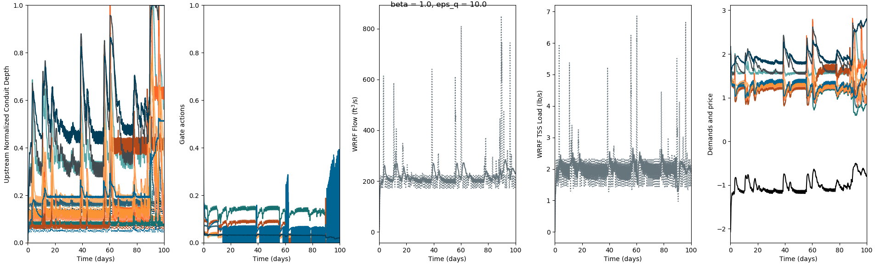
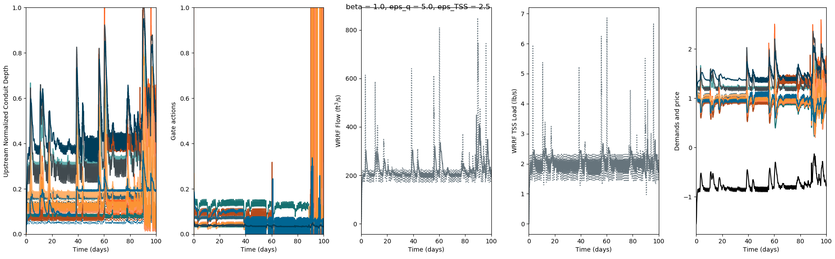
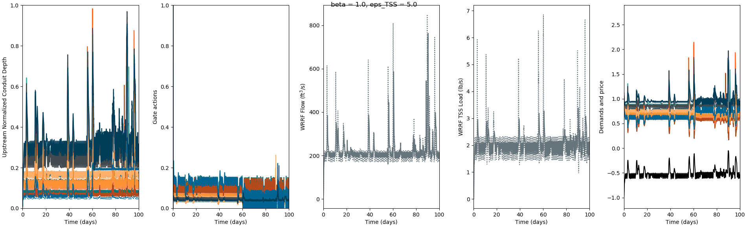
Trial A, 20, 5, 3

Slide 3
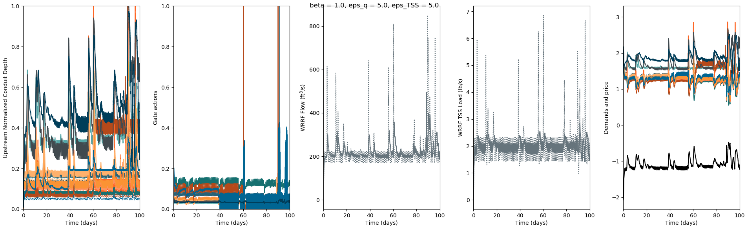
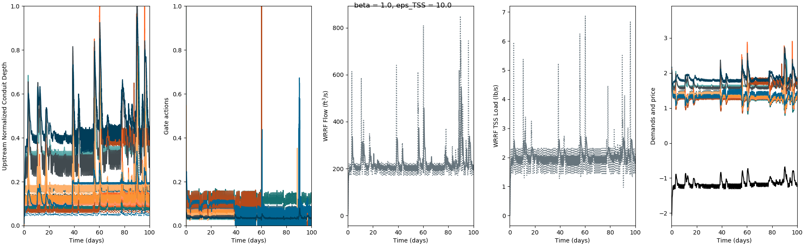
Trial B, 21, 5, 5

Slide 4
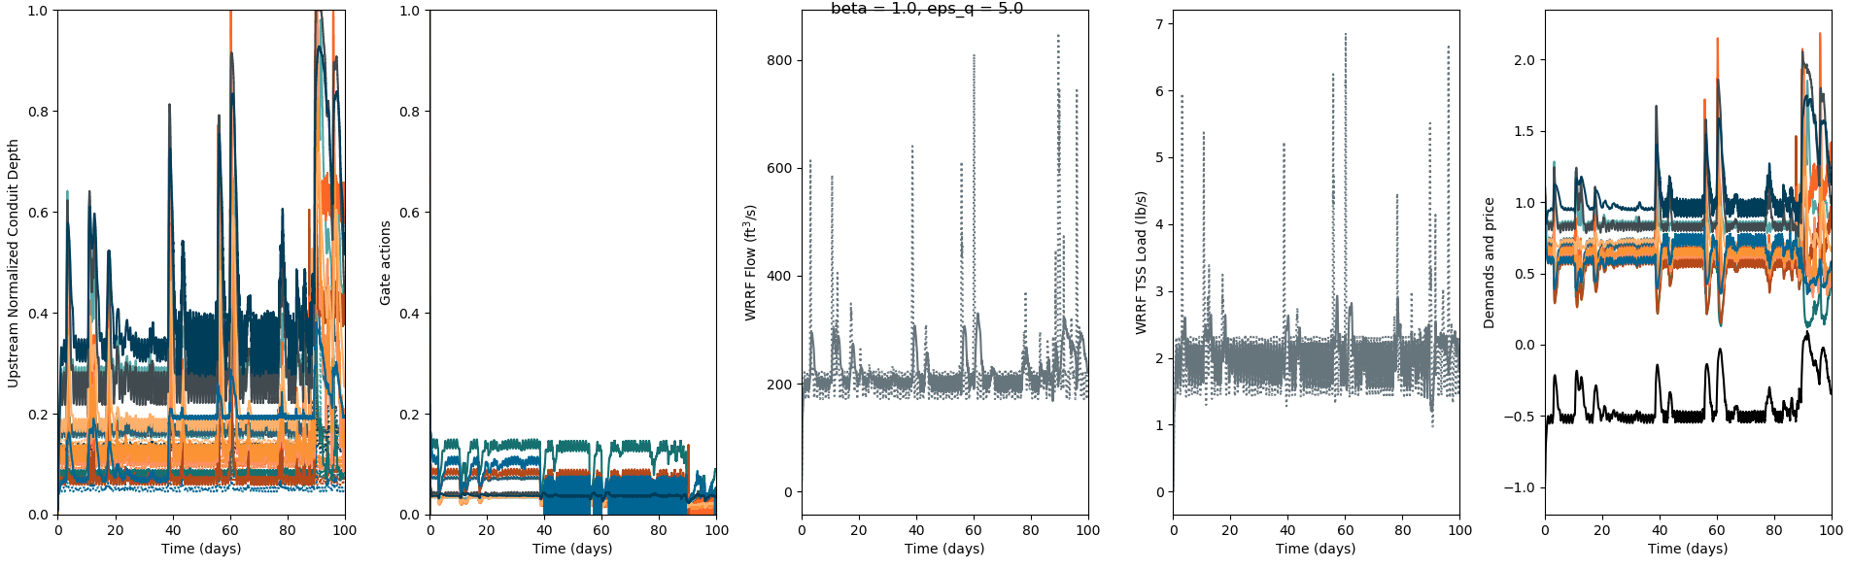
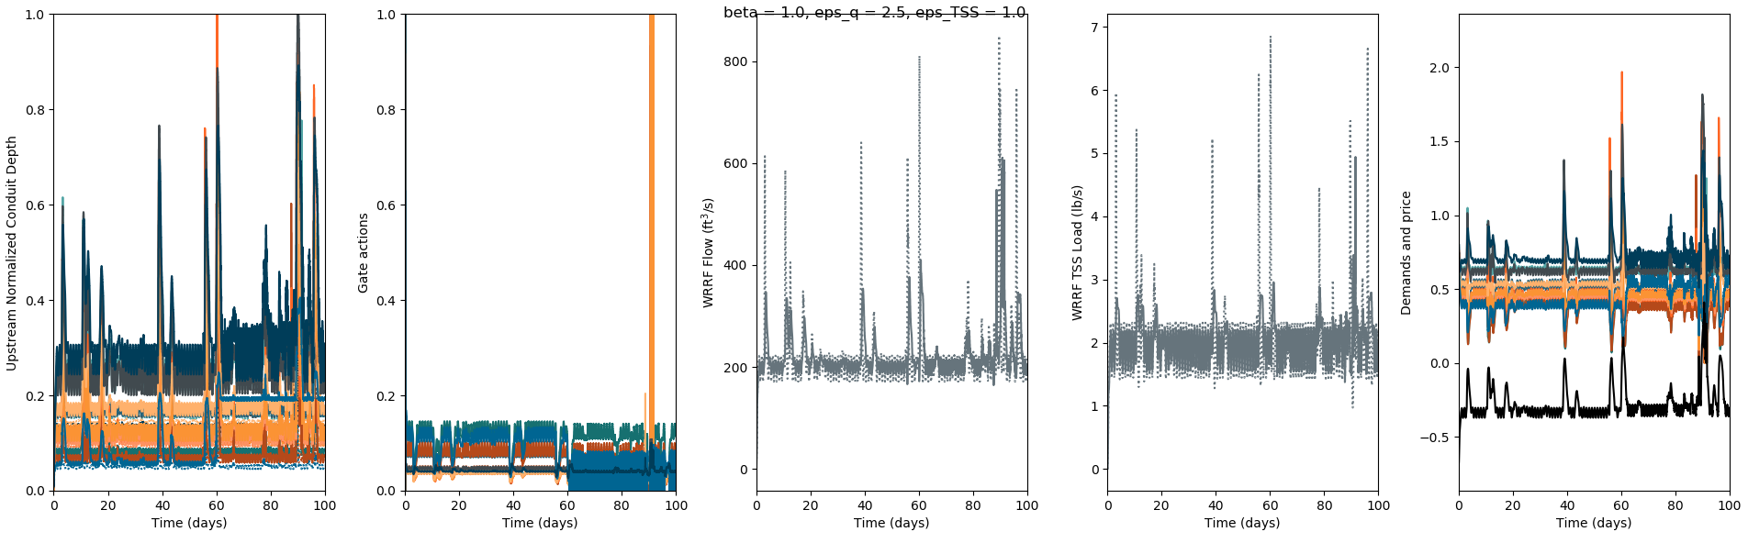
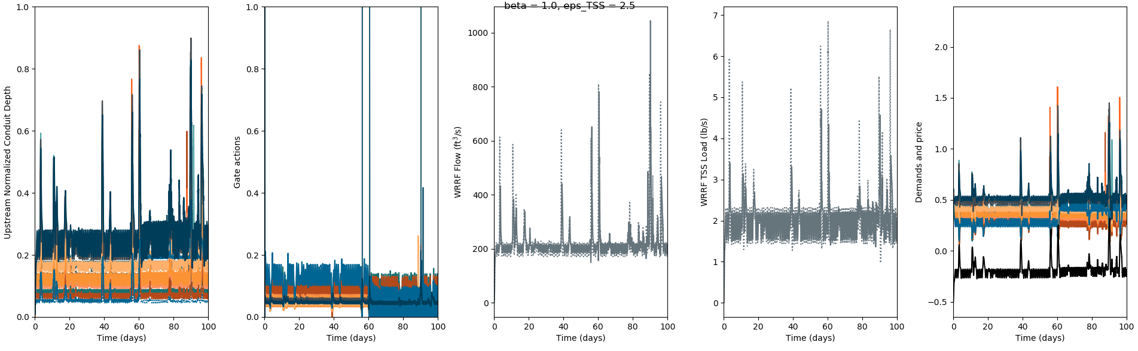
Trial C, 10, 3, 2

Slide 5
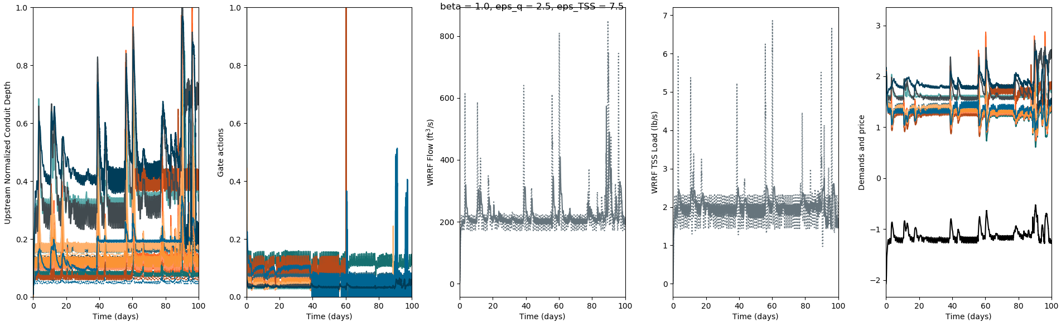
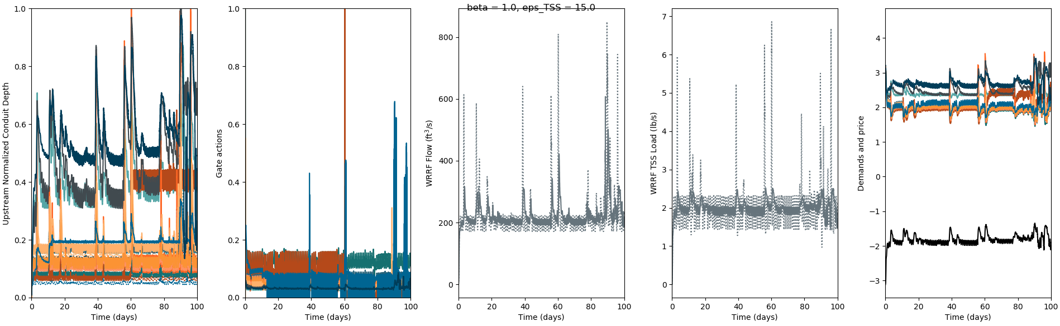
Trial D, 13, 3, 7

Slide 6
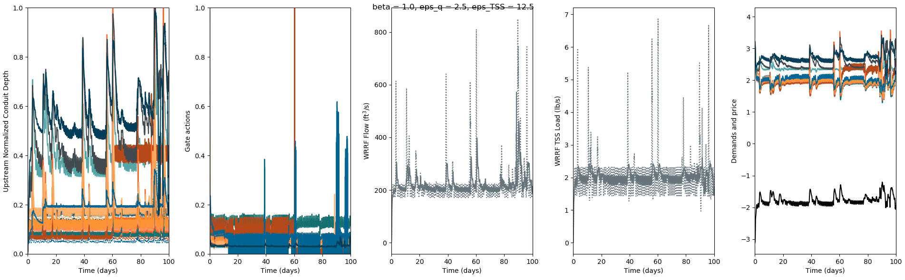
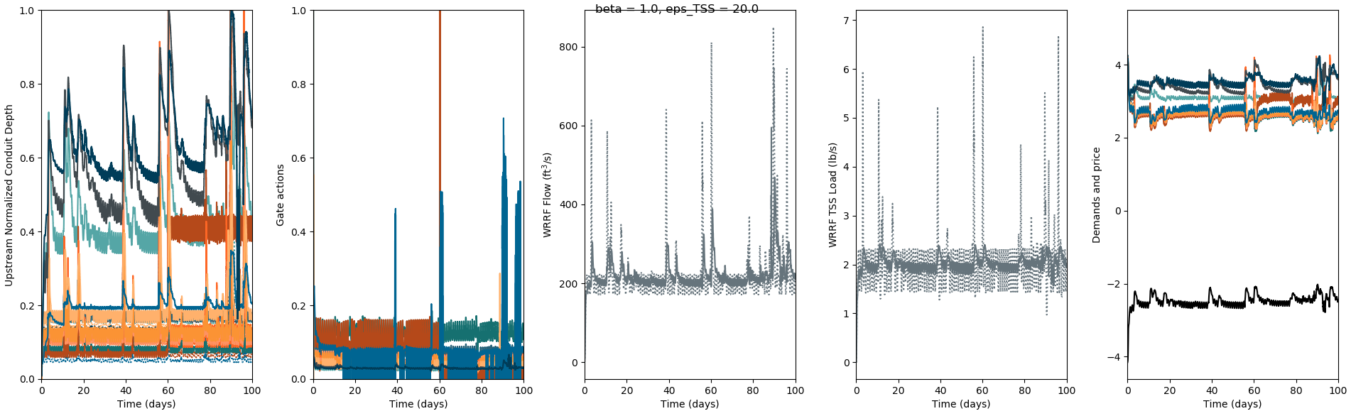
Trial E, 15, 3, 9

Slide 7
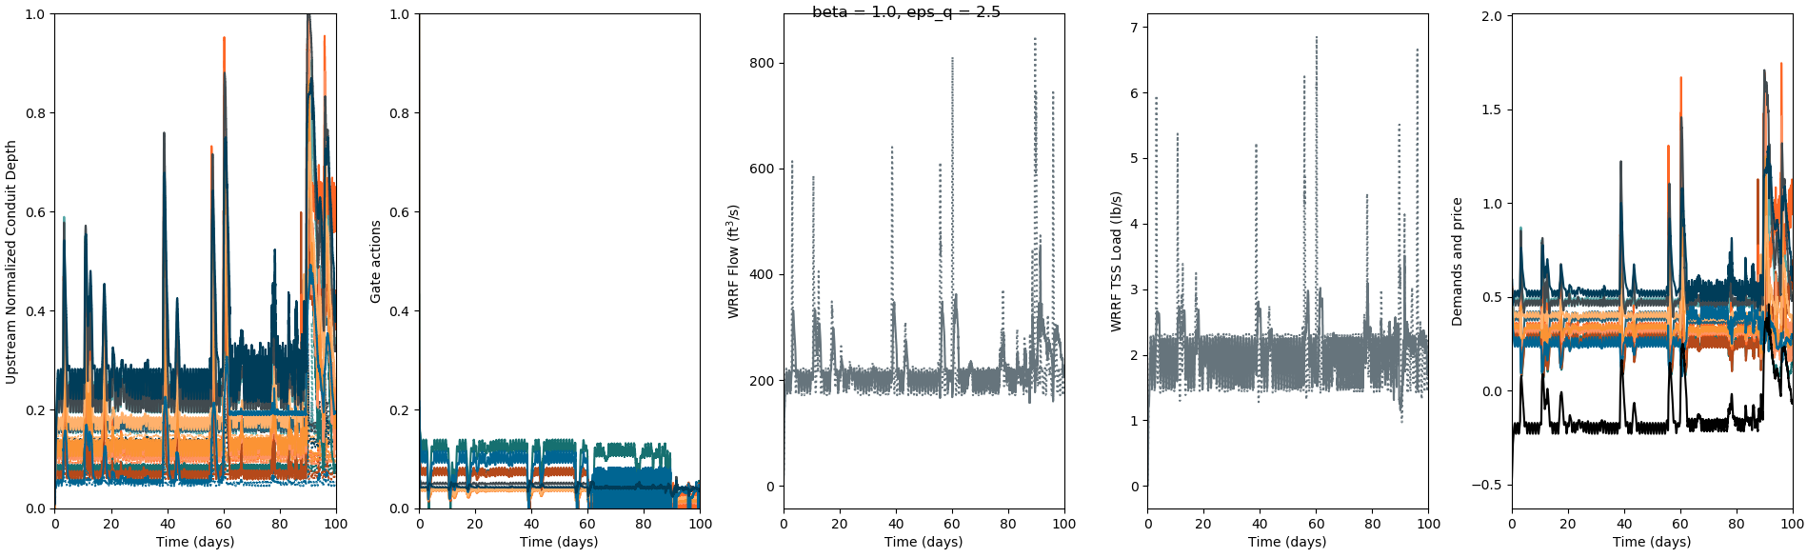

Trial F, 7, 2, 9

Slide 8

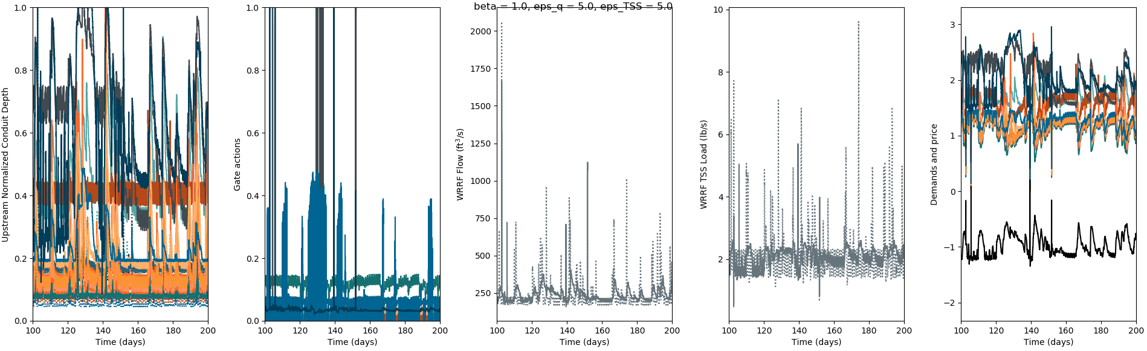
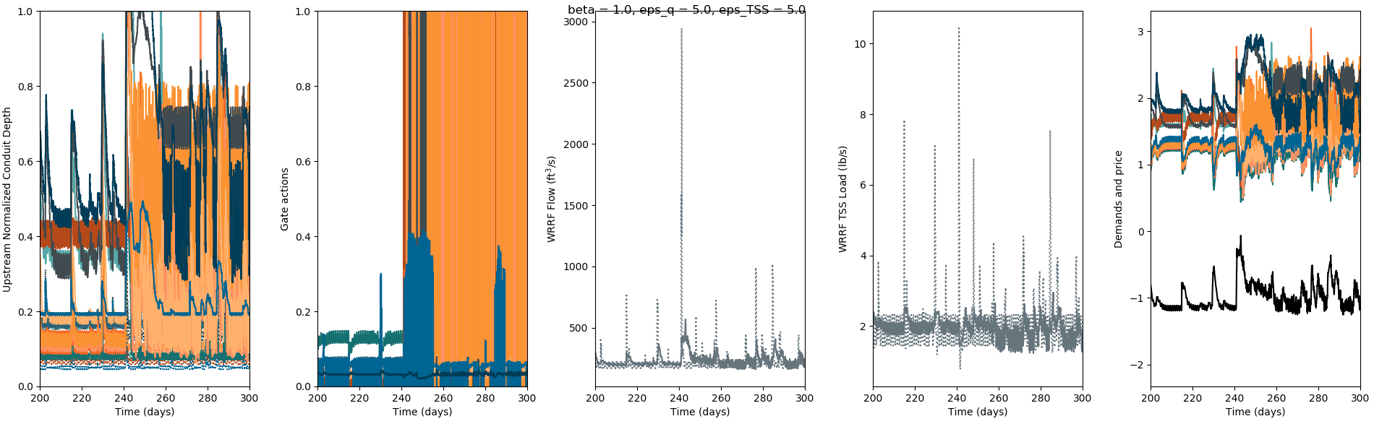
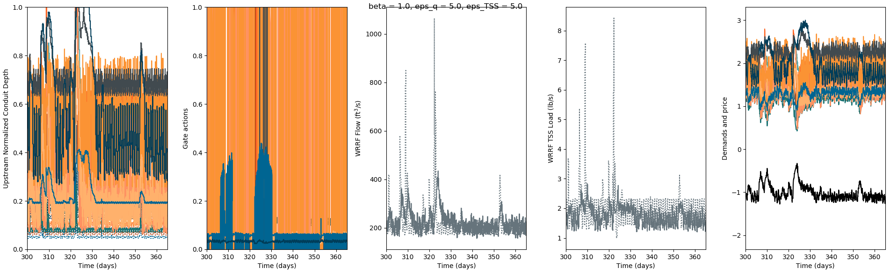

Slide 9
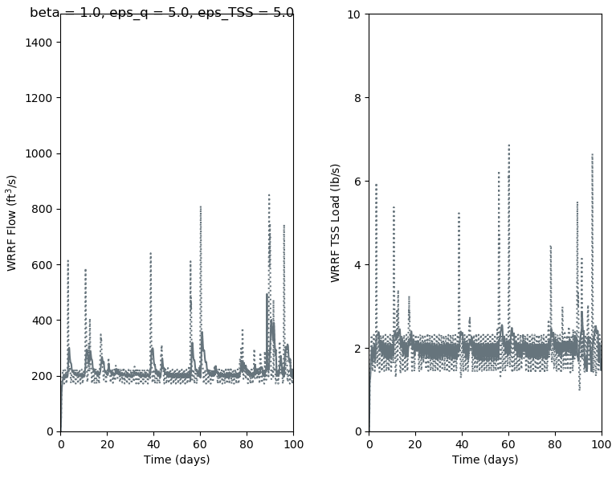
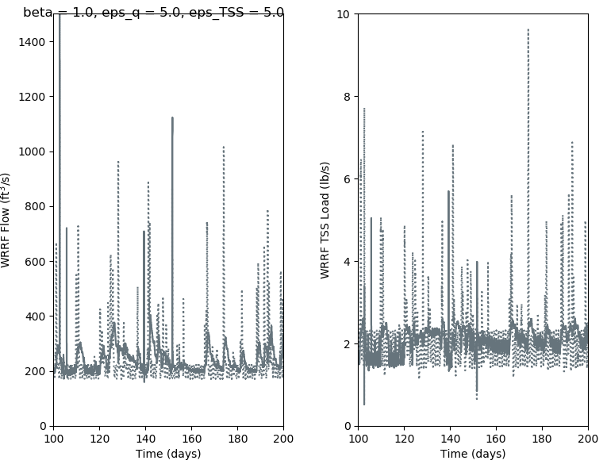
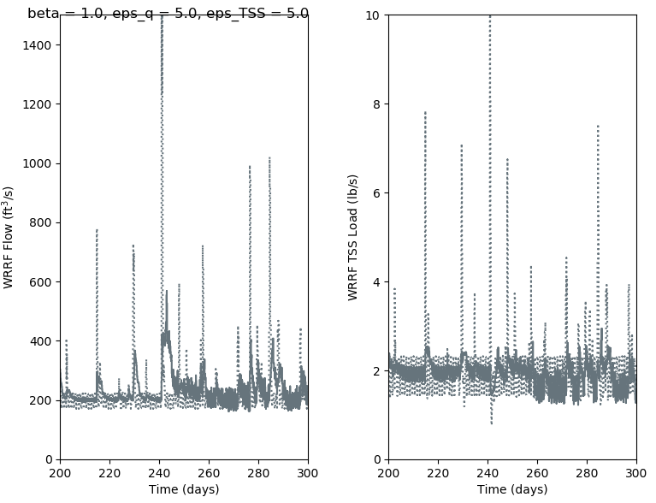
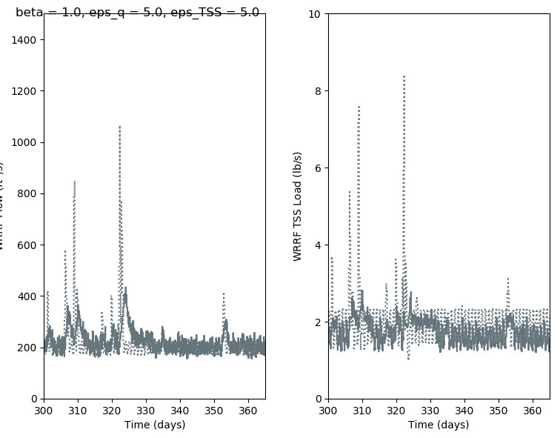

Slide 11
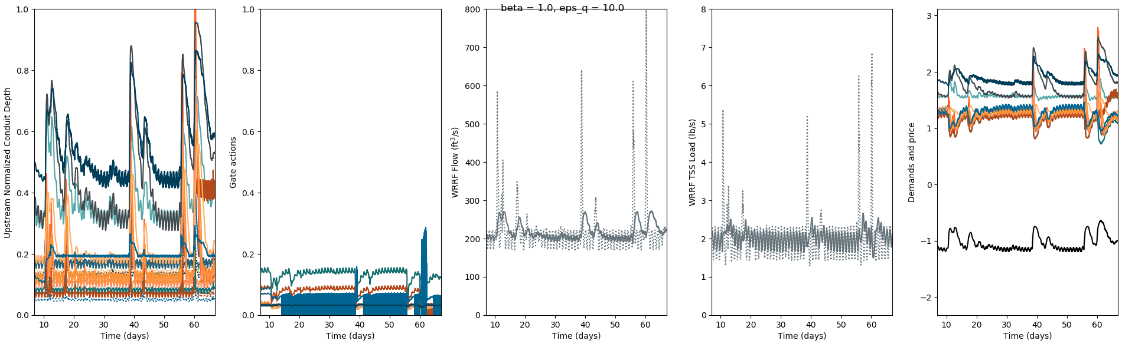
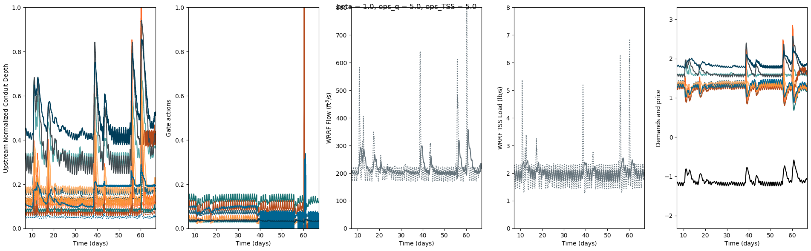
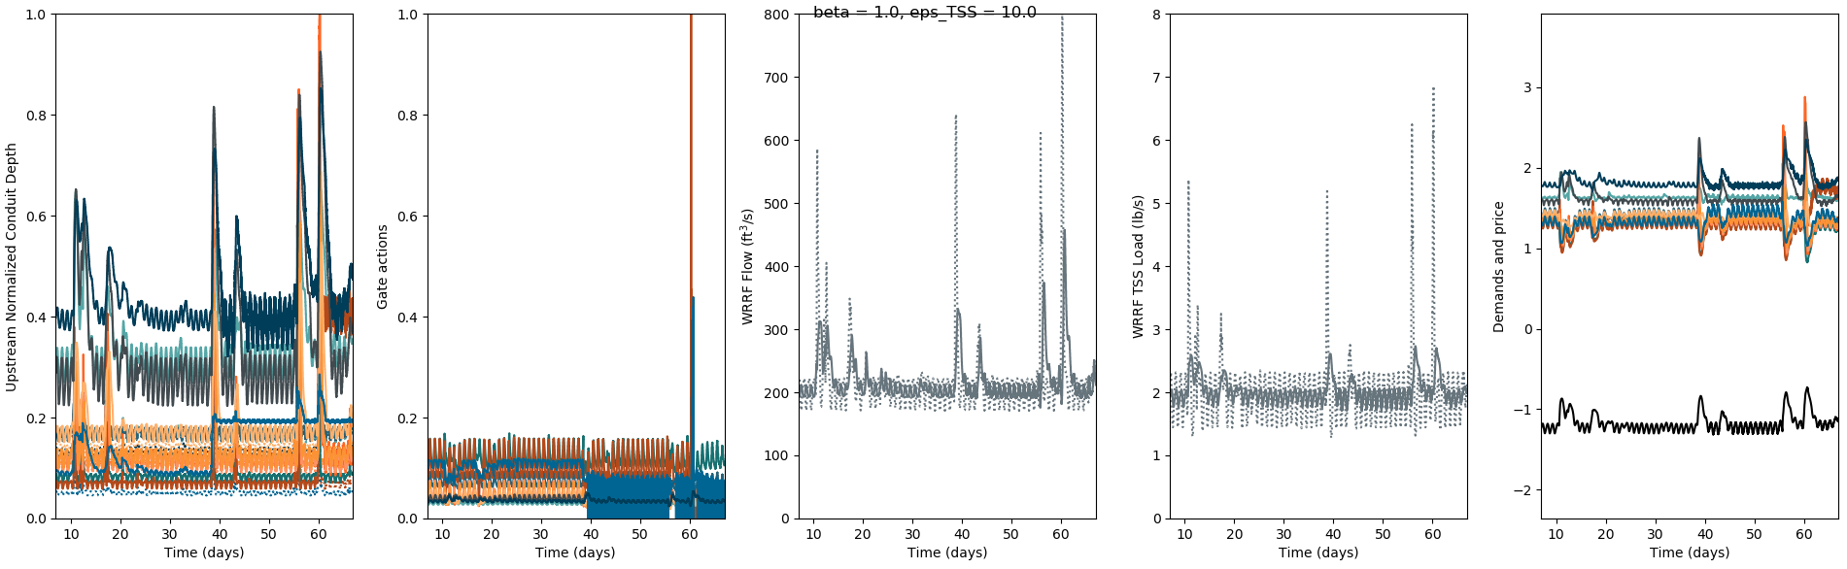
Trial B, 21, 5, 5

Slide 12
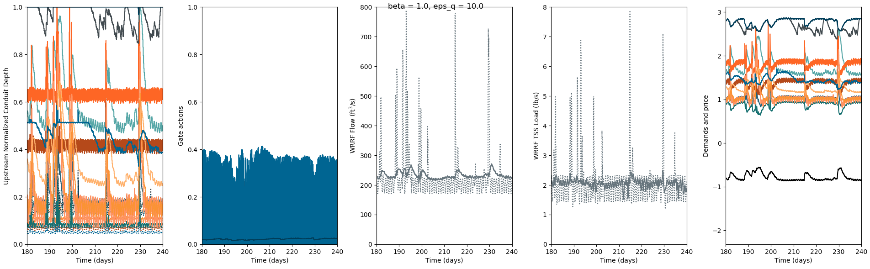
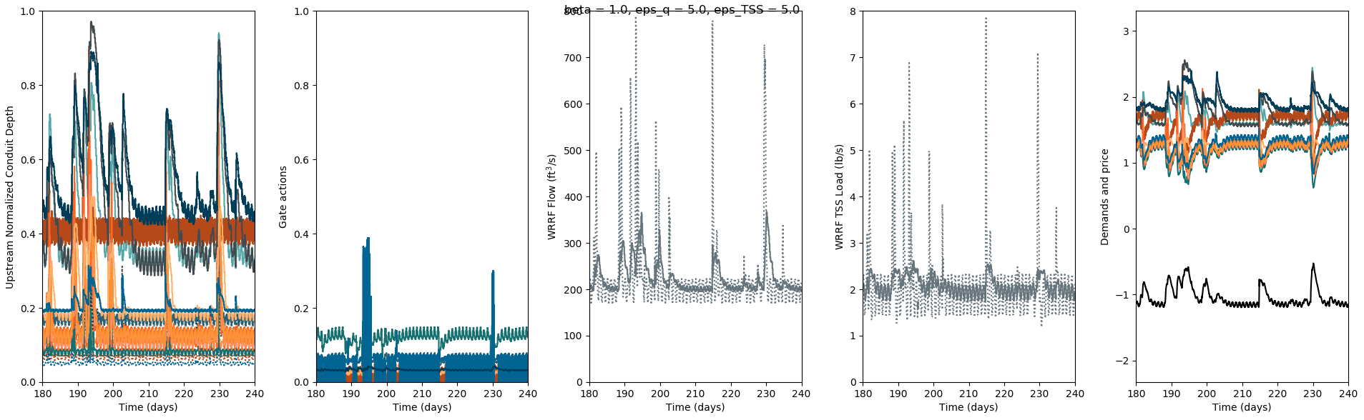
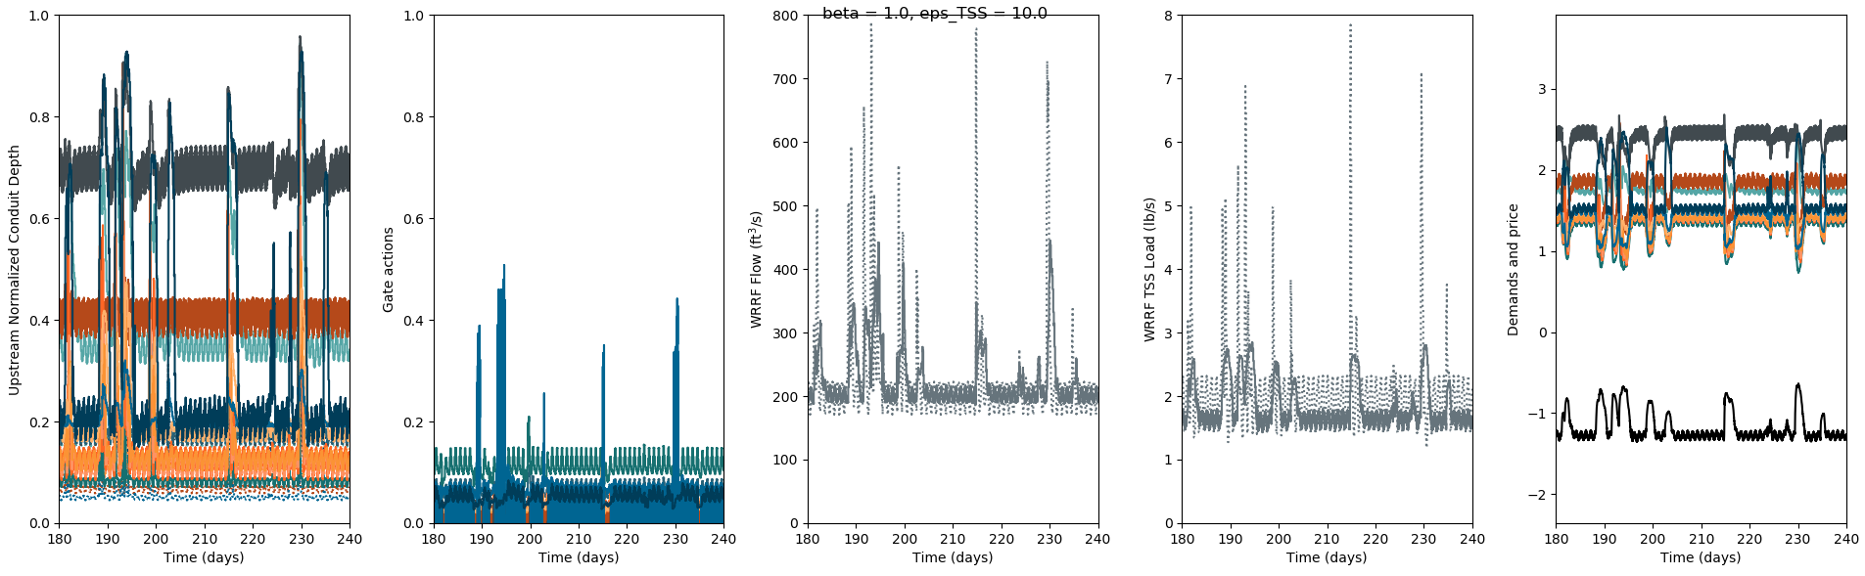
Trial B, 21, 5, 5

